Slide 1
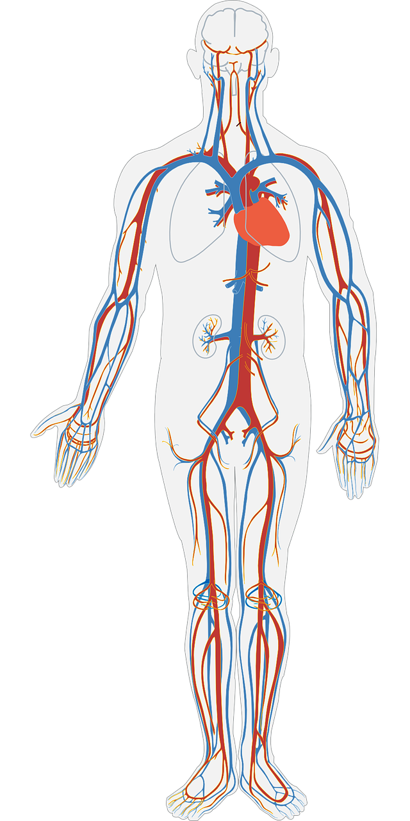
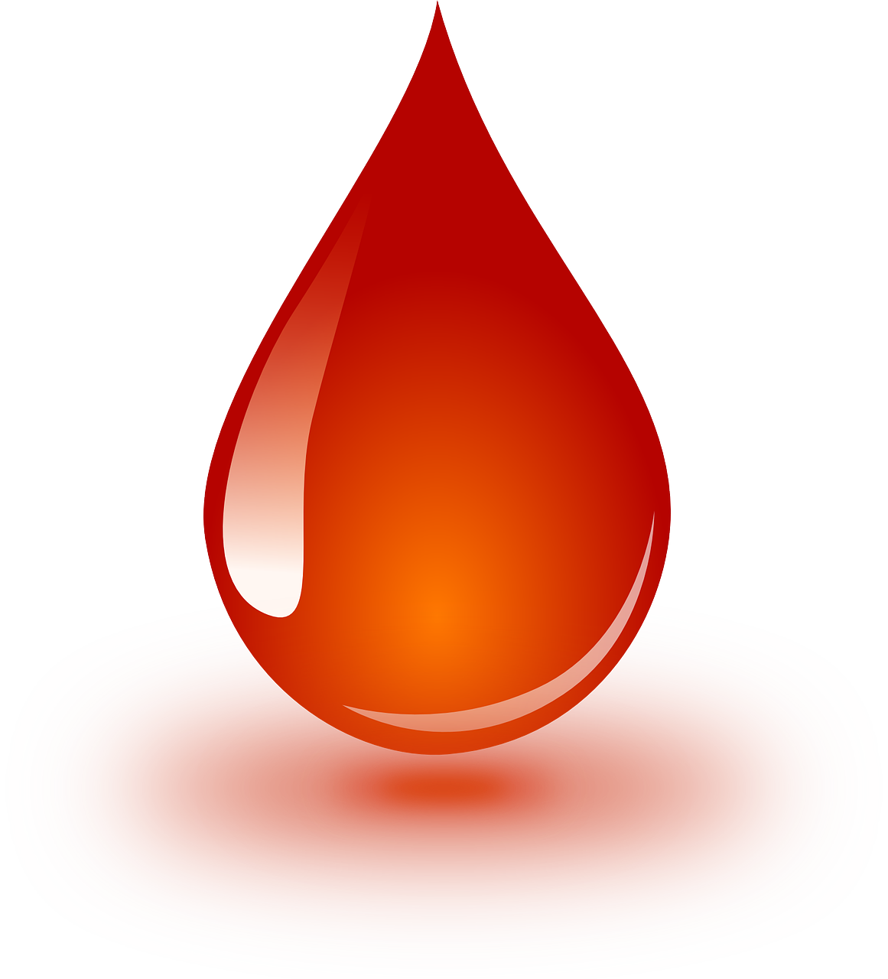
The Circulatory system
Class-7
Presented By- Rajnish Mani Pandey
( DIET U.S.Nagar )

Slide 2
Introduction
The circulatory system is transport system of our body.
It comprises blood, heart and blood vessels.
The circulatory system supplies nutrients to various part of body.

Slide 3

Blood
Blood is the body’s fluid which plays an important role in human circulatory system.
It’s main function is to circulate nutrients, hormones, minerals and other essential components to different parts of the body.
Blood is composed of four main things:
Plasma
Red blood cells
White blood cells
Platelets

Slide 4
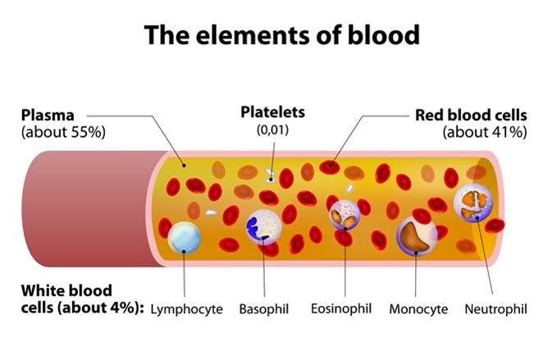
Plasma
Plasma is the liquid portion of blood.
55% of our blood is plasma.
Plasma helps maintain blood pressure and volume.
Plasma helps to maintain a proper pH balance in the body.

Slide 5
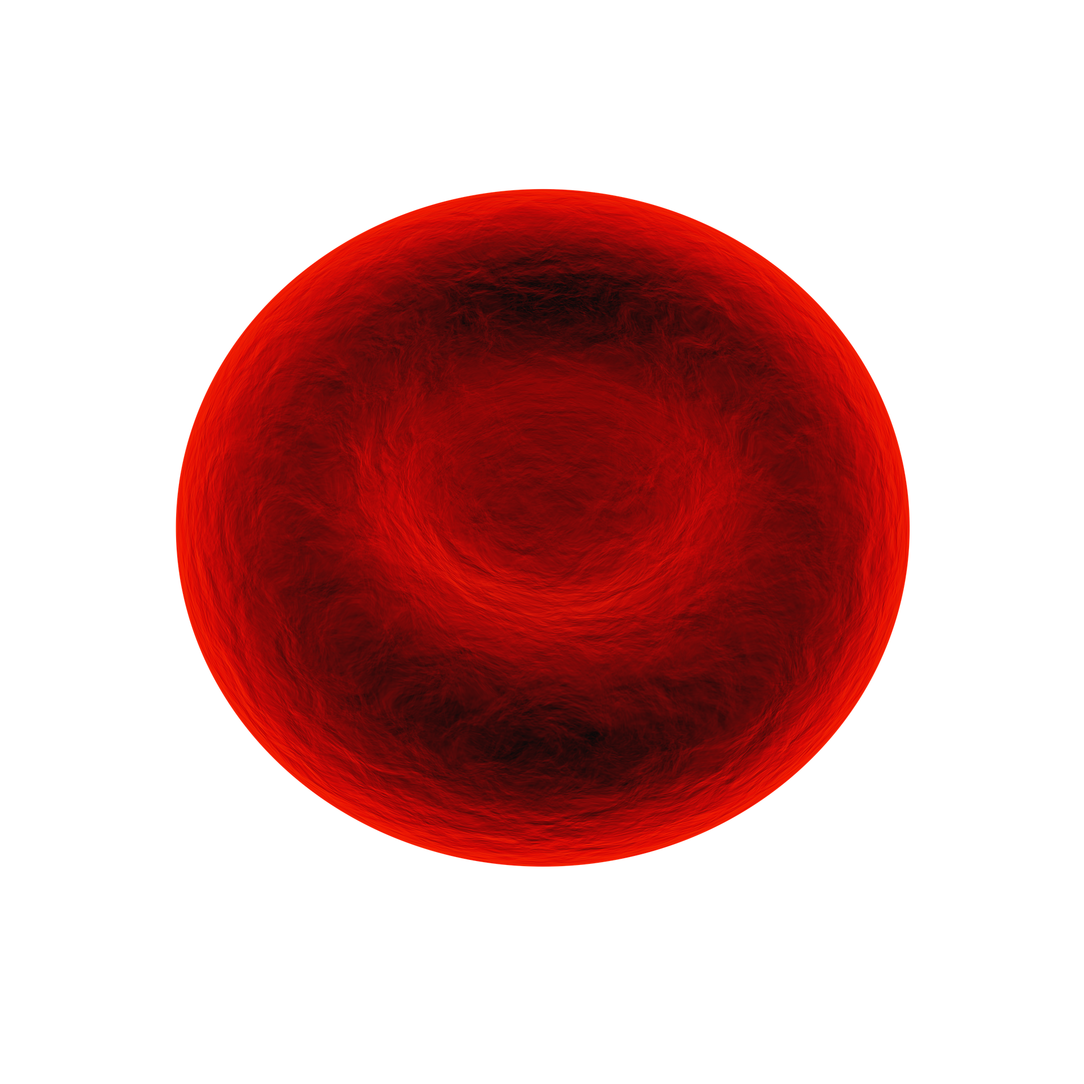
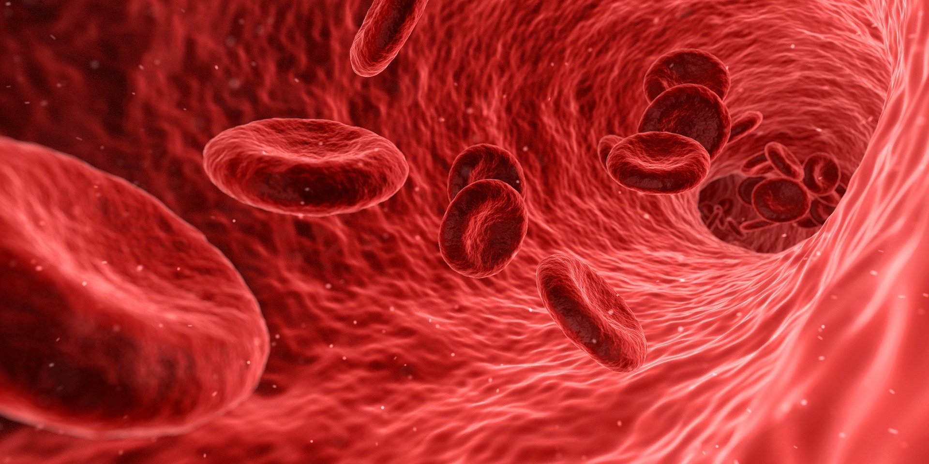
Red blood cells
Red blood cells are mainly involved in transporting oxygen, nutrients and other substances to various parts of the body.
These red blood cells also removes waste from the body.

Slide 6
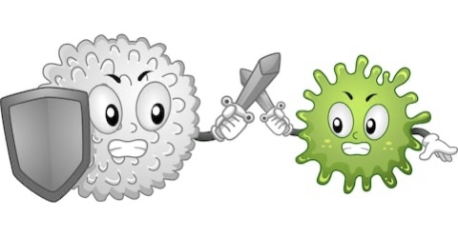
White blood cells
White blood cells are special cells which functions as a body’s defence system.
White blood cells provide immunity by killing pathogens and harmful microorganisms.

Slide 7
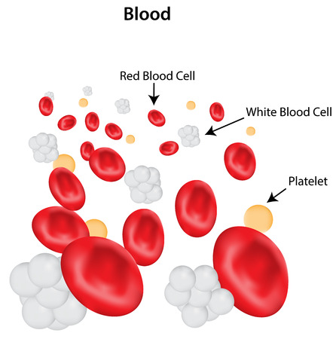
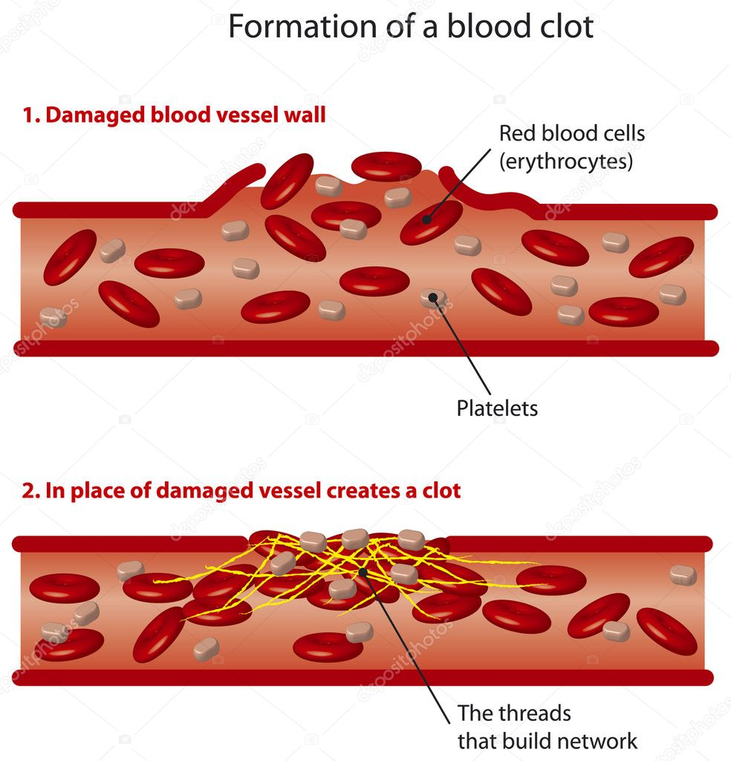

Platelets
Platelets are cells that help to form clots and stop bleeding.
If any blood cells gets damaged, it sends signals to the platelets and platelets then rush to the site of damage to fix it by clotting the blood.

Slide 8
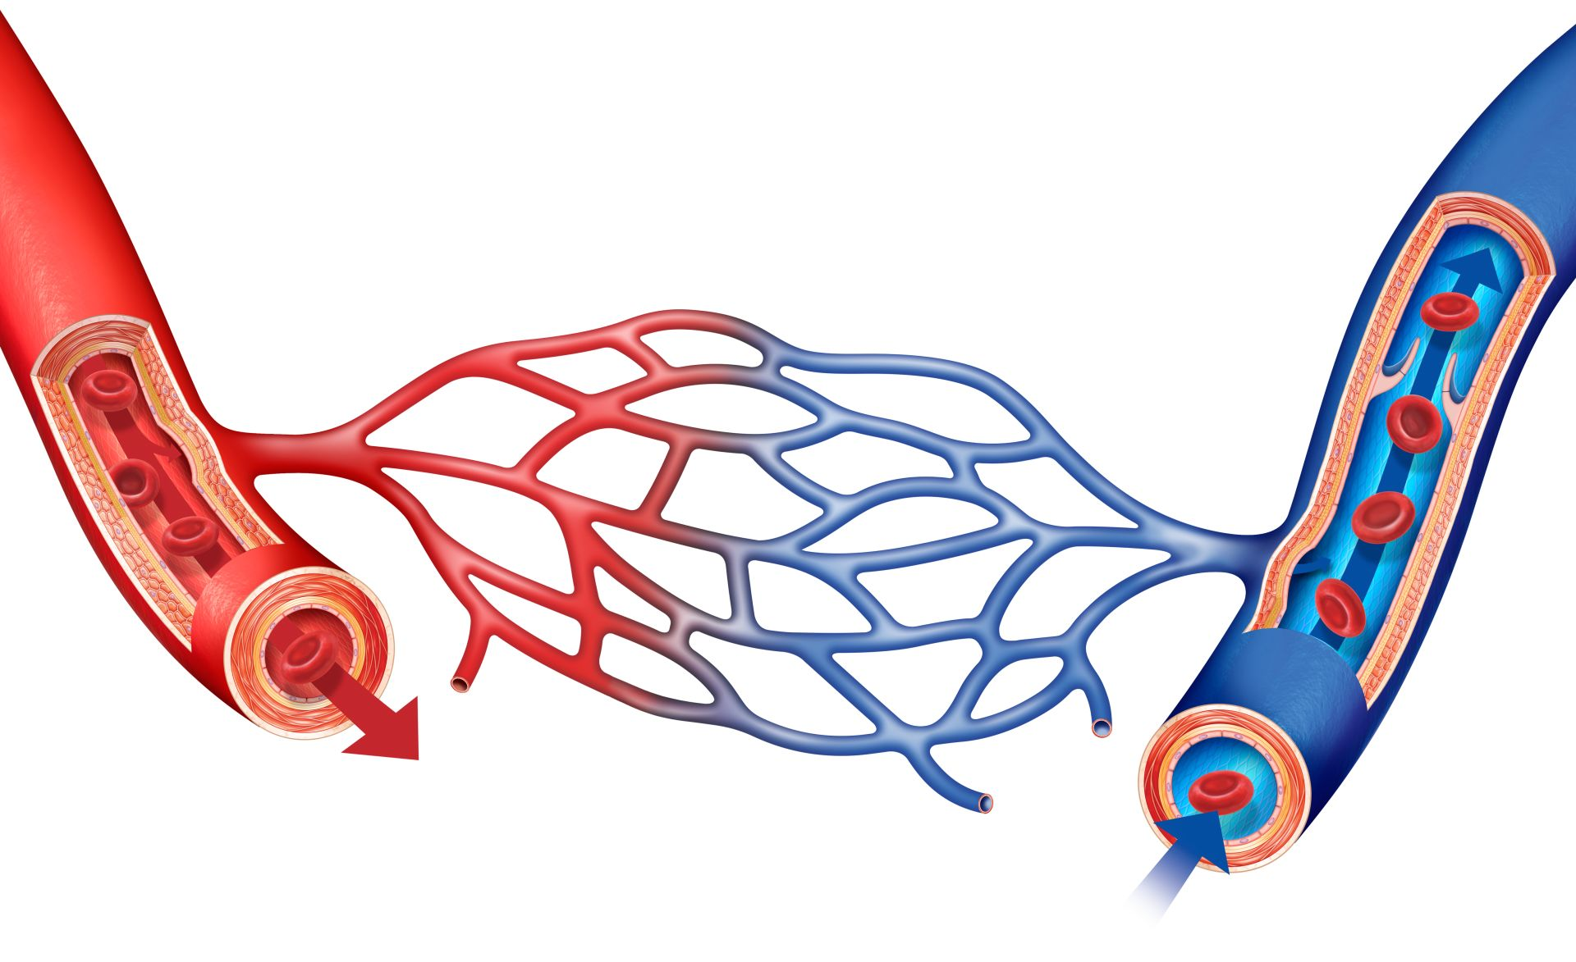
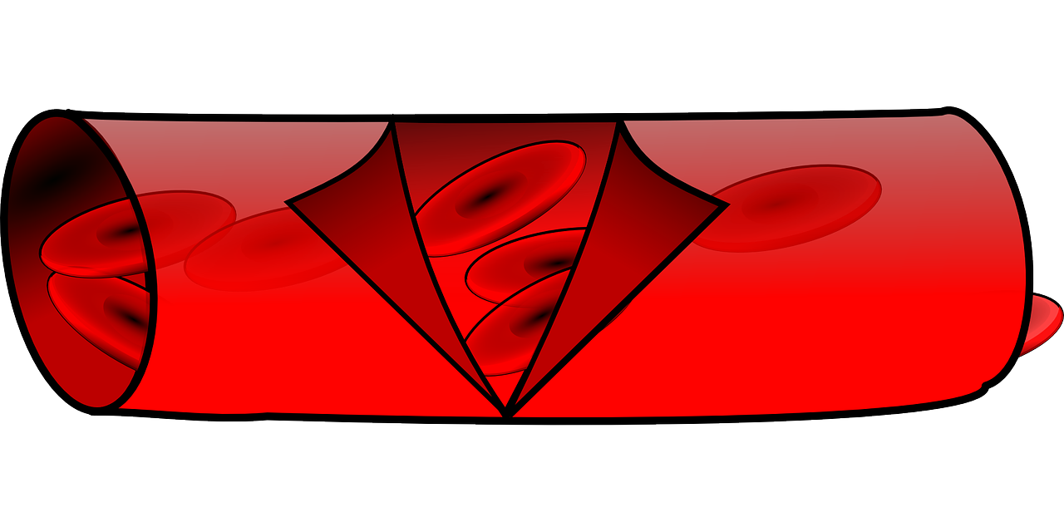
Blood Vessels
Blood vessels are a network of pathways through which blood travels throughout the body.
There are two primary types of blood vessels in the circulatory system of the body.
Arteries
Veins

Slide 9
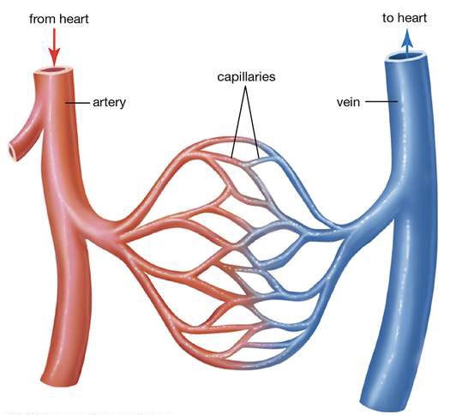
Arteries and veins
Arteries : Arteries are blood vessels that transport oxygenated (pure) blood from the heart to various parts of the body. They are thick, elastic and divided into a small network of blood vessels called capillaries.
Veins : Veins are blood vessels that carry deoxygenated (impure) blood towards the heart from various parts of the body. They are thin and elastic.

Slide 10
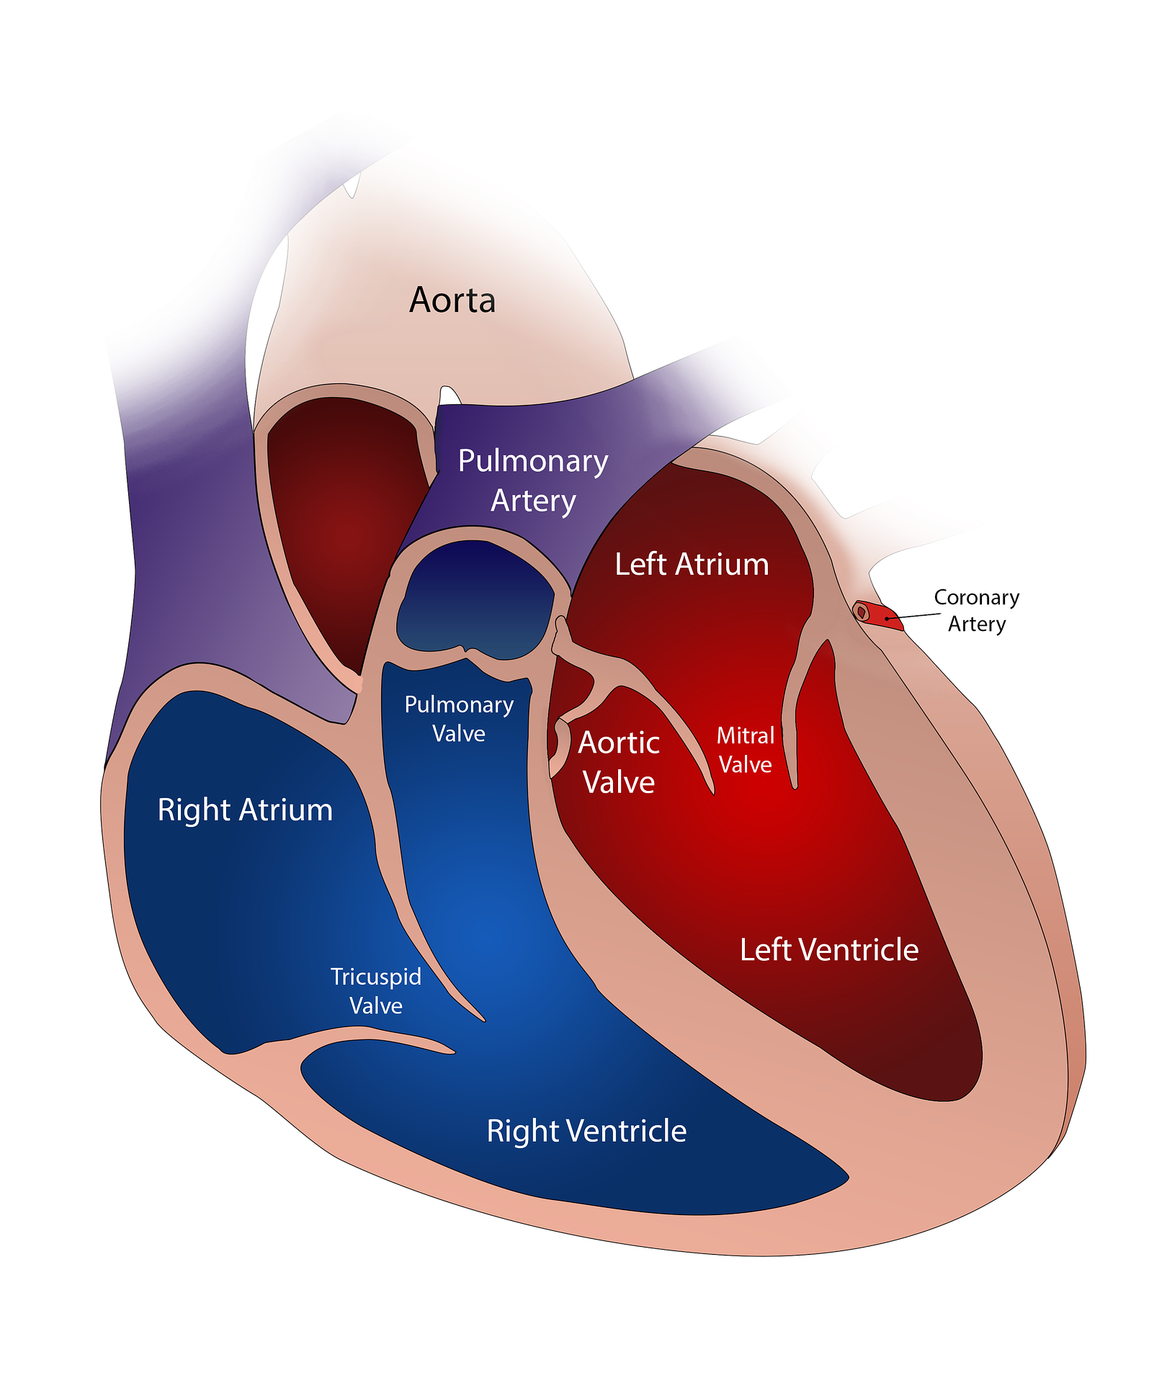
Heart
Heart is a muscular organ located in the chest cavity, right between lungs.
The human heart is separated into four chambers.
Two upper chambers are called - Atria ( singular : atrium )
Two lower chambers are called - Ventricles
Heart works like a pump non stop throughout our life.

Slide 11
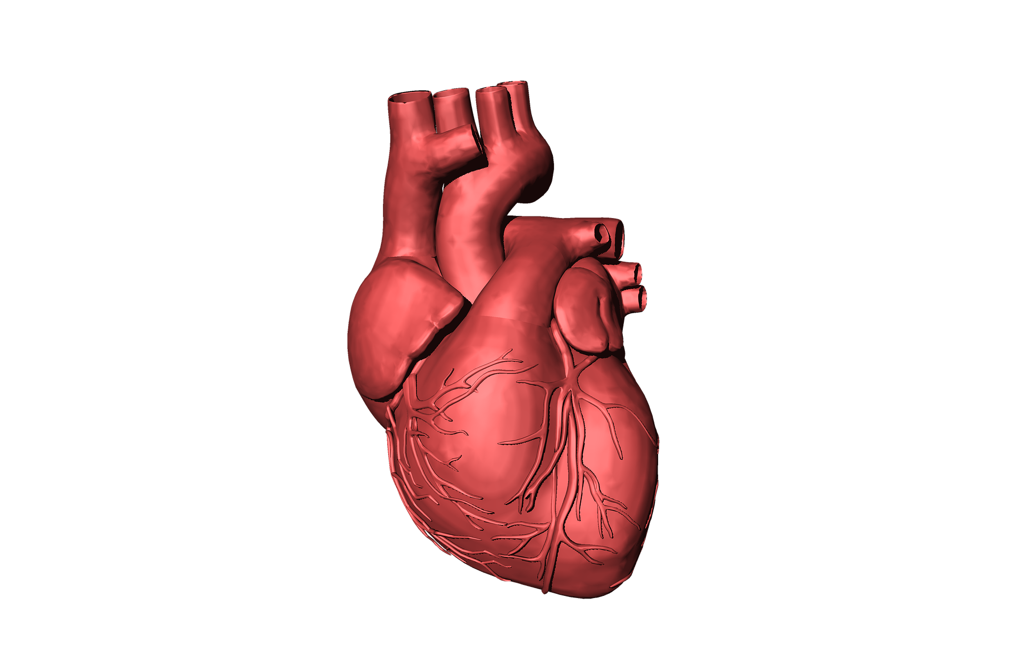

Slide 12
Double circulation
The blood flows in the human body in unique way.
The blood circulates through heart twice, hence it is called double circulation.
Animals like fish have single circulation.
The main advantage of double circulation is that every tissue in body gets steady supply of oxygenated blood and does not get mixed with deoxygenated blood.

Slide 13
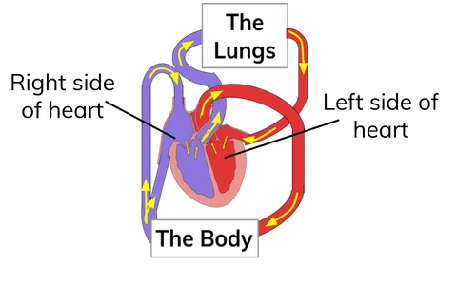

Slide 14
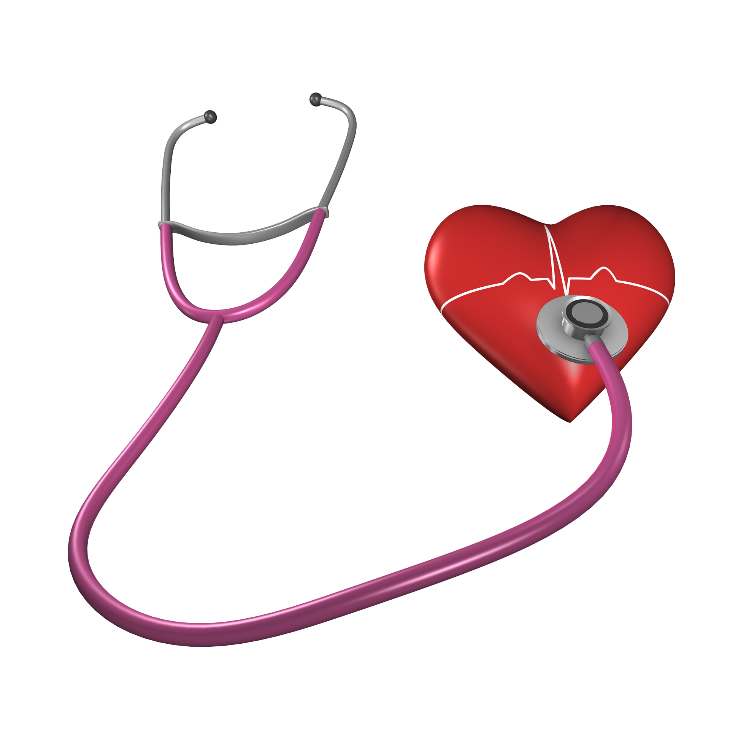
Heartbeat
The walls of the chambers of the heart are made up of muscles.
These muscles contract and reflex rhythmically.
This rhythmic contraction followed by relaxation constitute a heartbeat.
The doctor feels your heartbeat with the help of an instrument called - Stethoscope

Slide 15
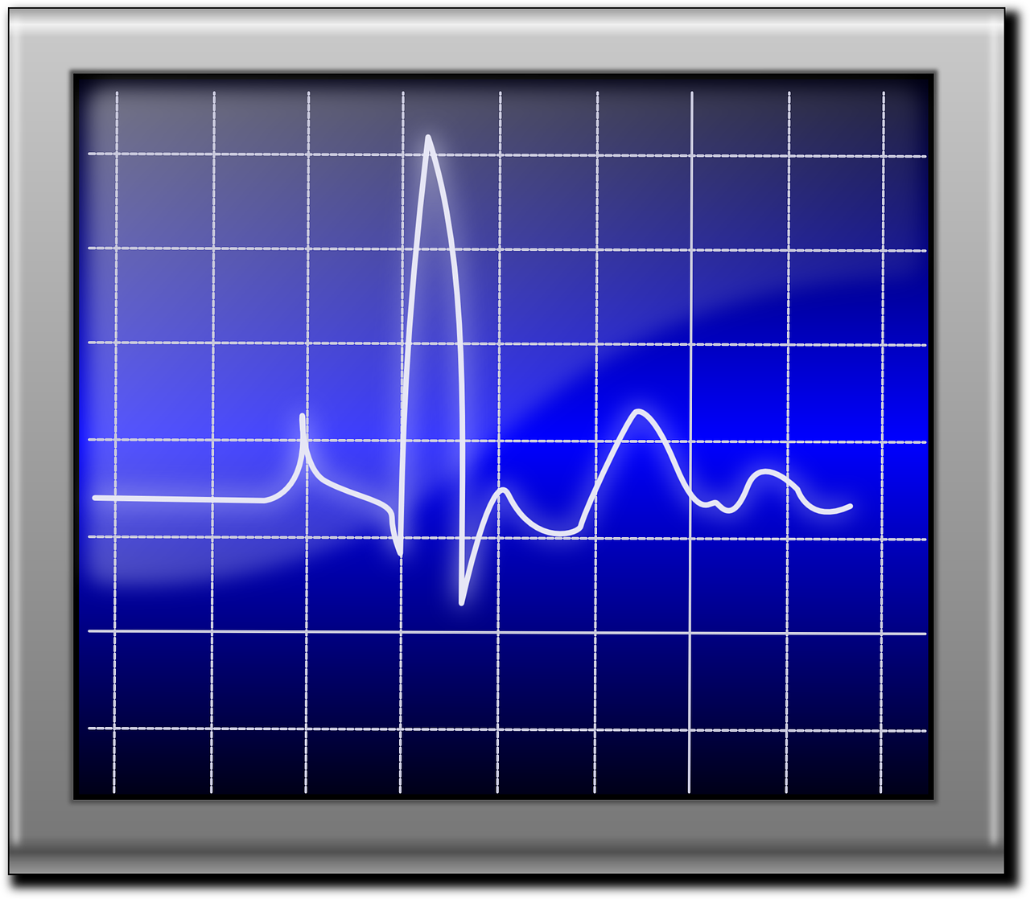

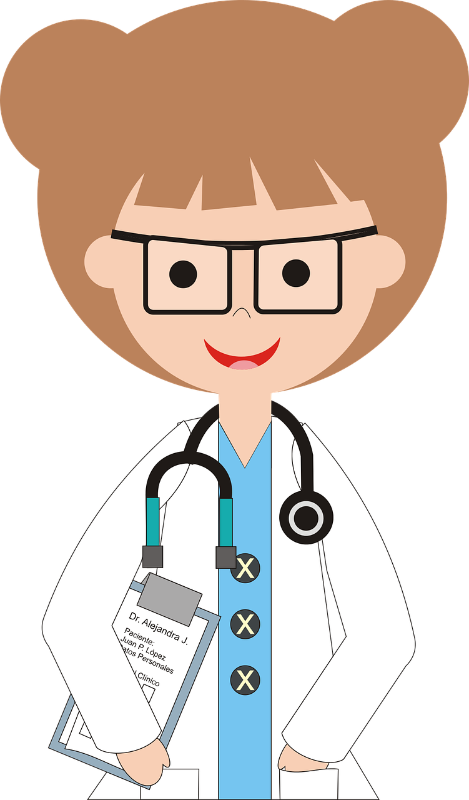

Slide 16


