Slide 1
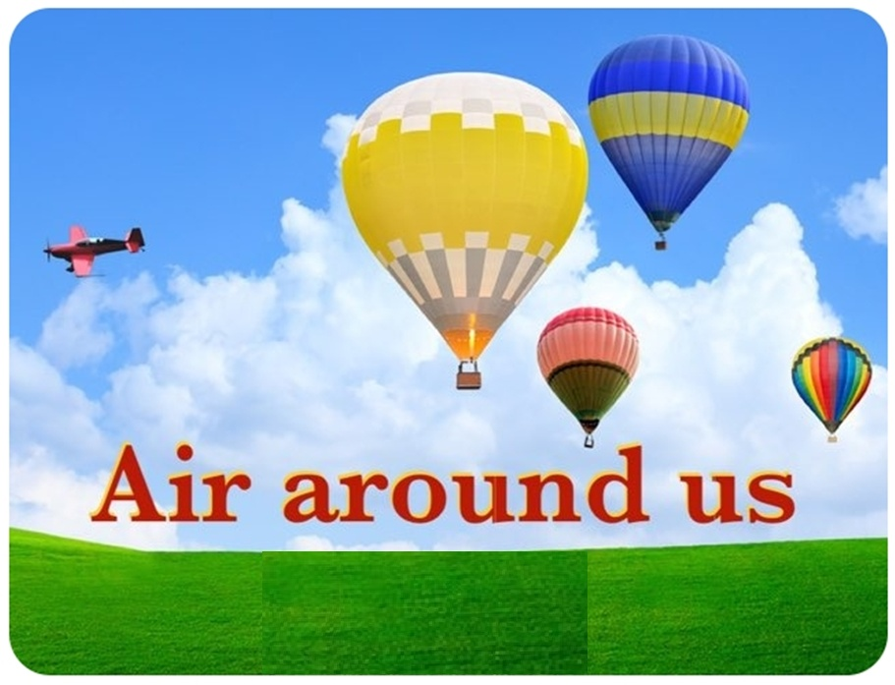

Chapter- 15, For class 6

Slide 2
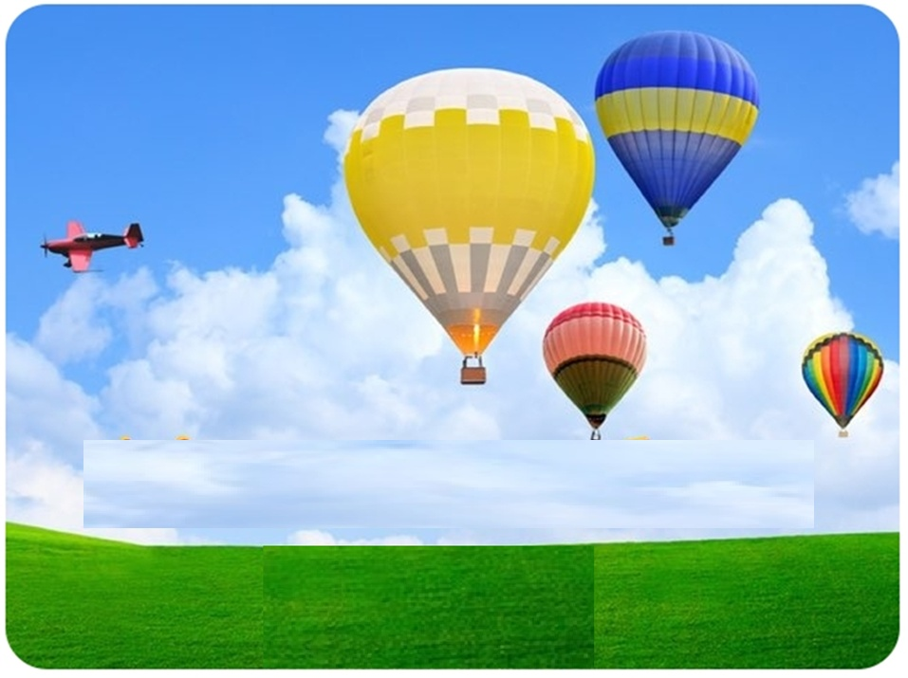

PRESENTED BY
Jeevan Singh Negi
Asstant Teacher
G. P. S. Baigul Dam khatta Sitarganj
SOUND RECORDED BY :-
Rashmi Chandra
GMPS kunwarpur sisaiya, sitarganj
Edited By :- Jeevan Singh Negi
GPS Baiguldam Khatta, sitarganj

Slide 3
TOPICS OF THIS LESSON
Is Air Present Everywhere Around us ??
What is Air Made up of ??
How does Oxygen become available to Animals and Plants ??
How is the Oxygen in the Atmosphere replaced ??

Slide 4

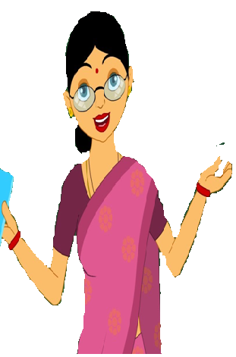
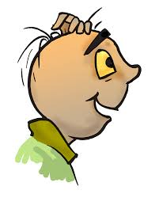
Good morning students…
Today we will learn about
Air round us.
Good morning mam…
What we are going to learn today?

Slide 5
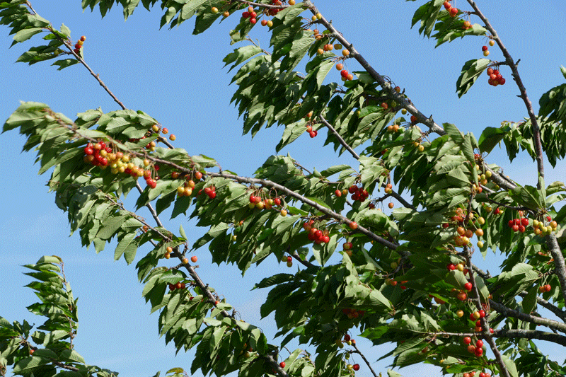
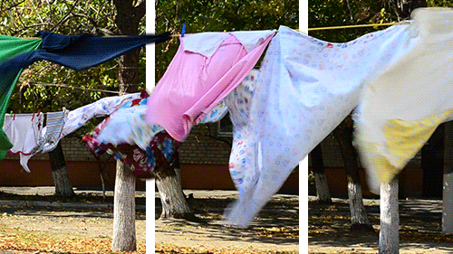

Children we have learnt that all living things require air. But have you ever seen air ? You might not have seen air, but surely you must have felt its presence in so many ways. You notice it when the leaves of the trees rustle or the clothes hanging on a clothes-line sway. Pages of an open book begin fluttering when the fan is switched on. The moving air makes it possible for you to fly your kite.

Slide 6
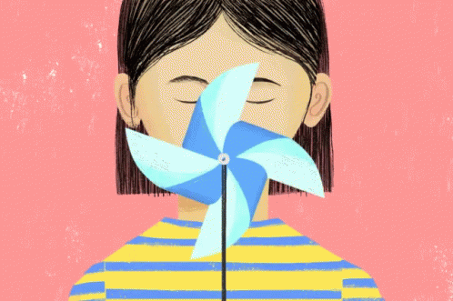
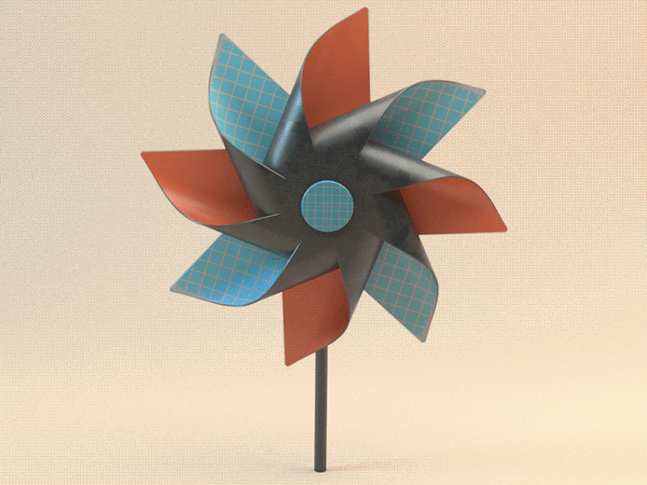
Have you ever played with a firki

Slide 7

Activity – 1st
Hold the stick of the firki and place it in different directions in an open area. Move it a little, back and forth. Observe, what happens. Does the firki rotate? What makes a firki to rotate – moving air, isn’t it?

Slide 8
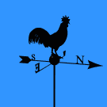
Have you seen a weather cock ?
It shows the direction in which the air is moving.

Slide 9
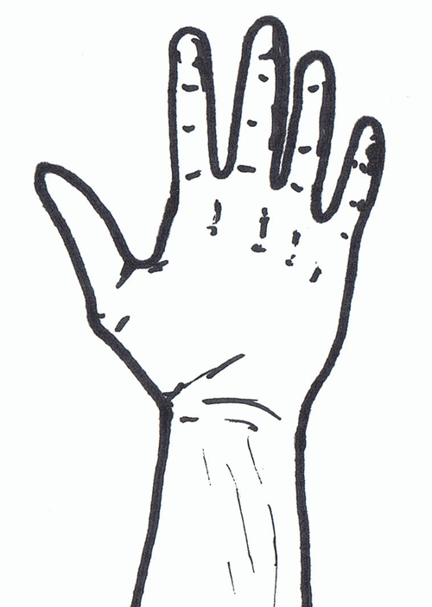
IS AIR PRESENT EVERYWHERE AROUND US ?
Close your fist – what do you have in it? Try the following activity to find out.

Slide 10
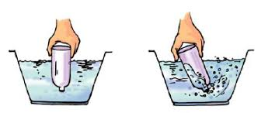
Activity – 2
Take an empty open bottle. Is it really empty or does it have something inside ? Turn it, upside down. Is something inside it now ? Now, dip the open mouth of the bottle into the bucket filled with water. Observe the bottle. Does water enter the bottle? Now tilt the the bottle slightly. Does the water now enter the bottle ? Do you see bubbles coming out of the bottle or hear any bubbly sound? Can you now guess what was in the bottle?

Slide 11
Yes.. You are right. It is air that was present in the bottle. The bottle was not empty at all.
This activity shows that air occupies space. It fills all the space in the bottle.
It is present everywhere around us.
Air has no colour. It is transparent.

Slide 12
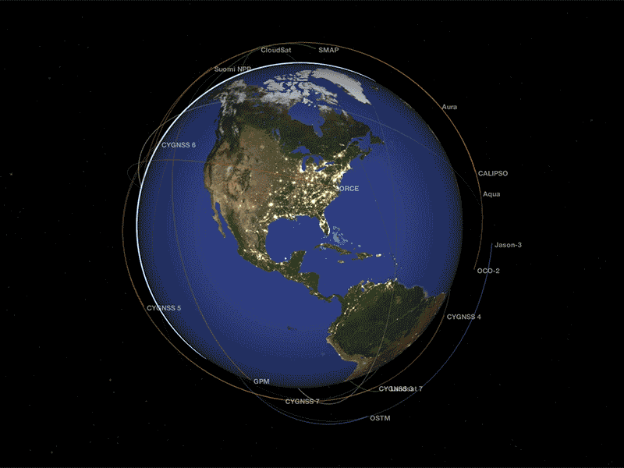
Our earth is surrounded by a thin layer of air. This layer extends up to many kilometers above the surface of the earth and is called atmosphere, the air gets rarer ,as we move higher in the atmosphere.

Slide 13
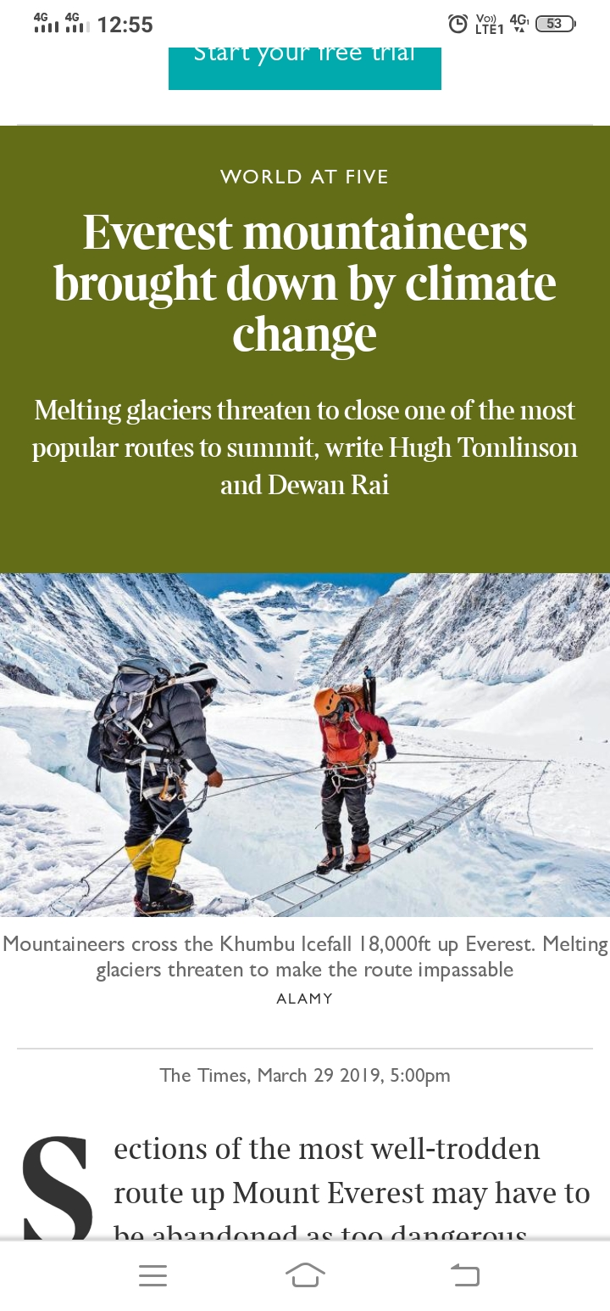
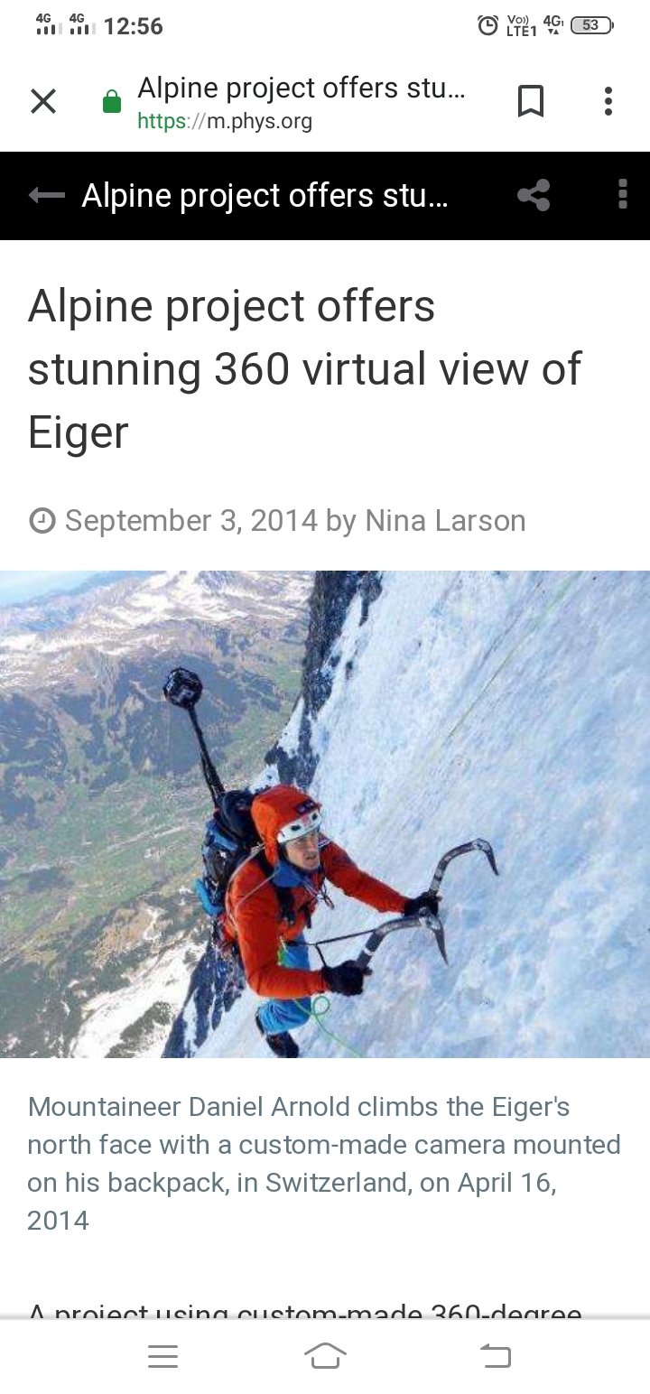
Now can you think, mountaineers carry oxygen cylinders with them, while climbing high mountains.

Slide 14

Students do you know What is air made up of ?
Until the eighteenth century, people thought that air was just one substance. Experiments have proved that it is really not so. Air is a mixture of many gases like nitrogen, oxygen, carbon di oxide,water vapour and other gases.

Slide 15
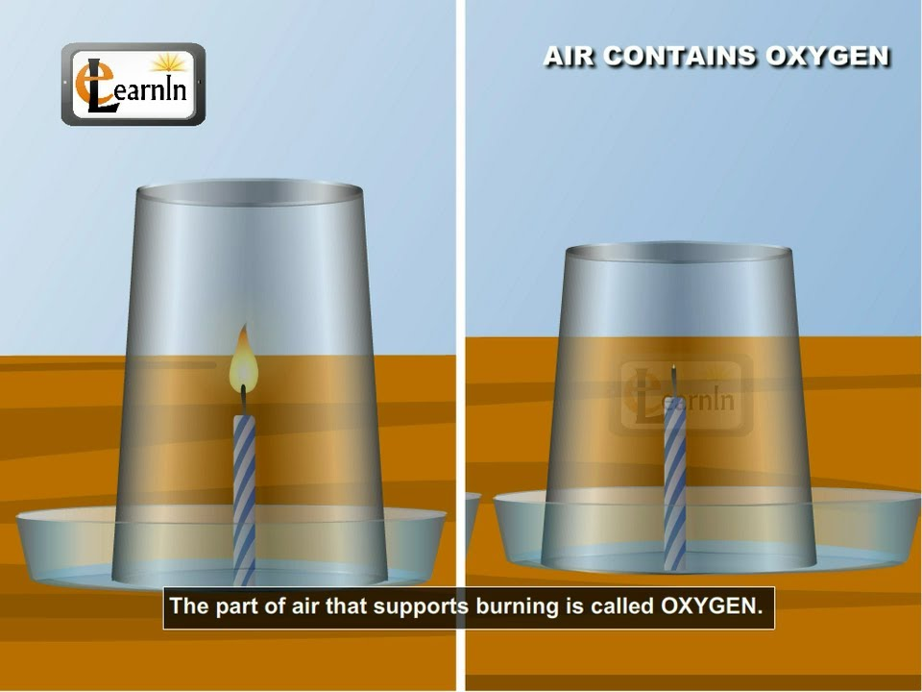
Oxygen
Activity – 2
Fix two small candles of same length on a table. Light both the candles. Cover one of the candles with an inverted glass tumbler. Observe both the candles carefully .
Do both the candles continue to burn or go off ?
you must have observed that the candles cover with glass tumbler got extinguished after some time, whereas the other candle continued burning.
It seems that the candle got extinguished because the component inside of the glass tumbler, which support burning, is limited. Most of the component is used up by the burning candles. However, the other candle is getting continued supply of air. This component of air, which supports burning, is known as oxygen.

Slide 16
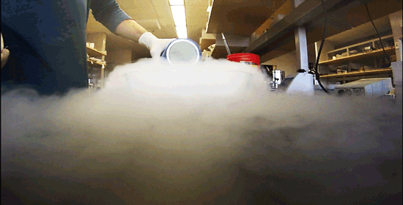
Nitrogen
In the burning candle activity did you observe that air is still present in the glass bottle even after the candle blew out? This indicates the presence of some component in the air, which does not support burning. The major part of air (which does not support burning candle) is Nitrogen.

Slide 17

Do you see some shining particles moving in the beam of sunlight? what are these particles.
These are dust particles.the presence of dust particles in air varies from time to time and place to place.

Slide 18
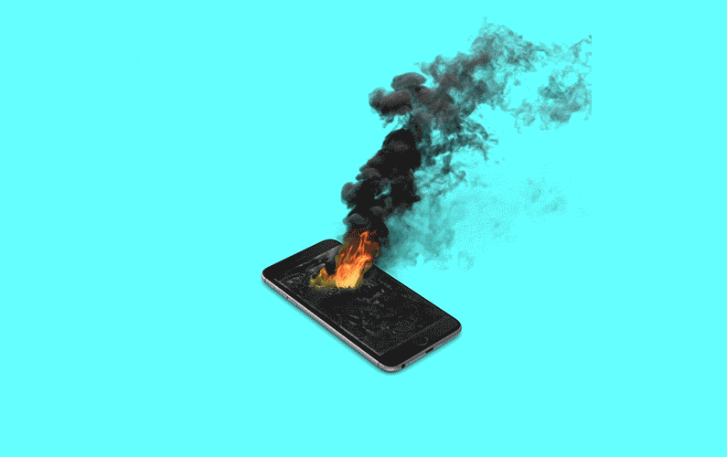
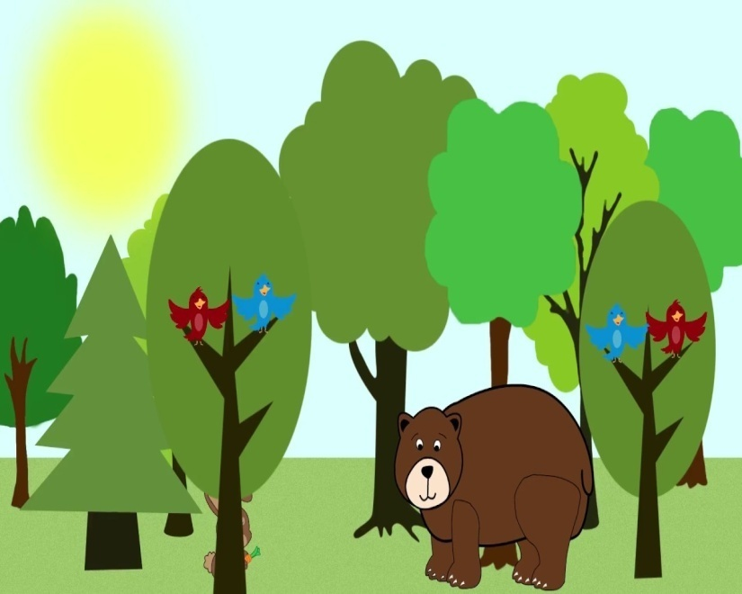
Carbon dioxide
in a close room, if there is some material that is burning, you may have felt suffocation. This is due to excess of carbon dioxide that may be accumulating in the room, as the burning continues . Carbon dioxide makes up a small component of the air around us. Plants and animals consume oxygen for respiration and produce carbon dioxide.

Slide 19
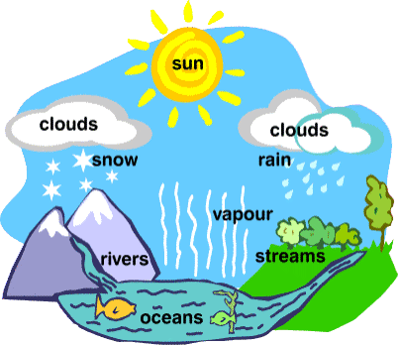
Water vapour
When air comes in contact with a cool surface, it condenses and drops of water appear on the cooled surface. The presence of water vapour in air is important for the water cycle in nature.

Slide 20
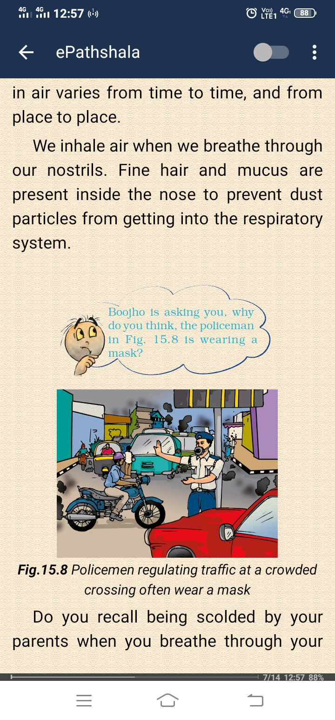

Boojho is asking you, why do you think, the policeman is wearing a mask

Slide 21
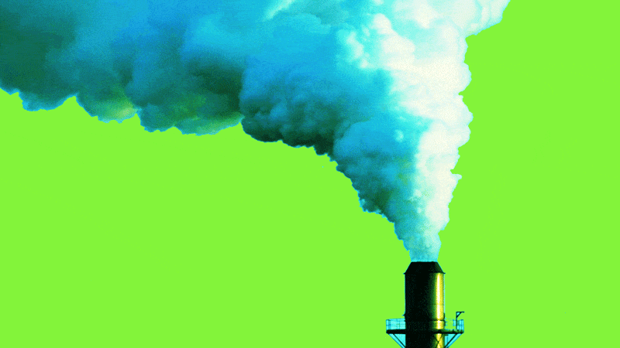
Dust and Smoke
The burning of fuel also produces smoke. Smoke contains a few gases and fine dust particles and is often harmful. That is why you see long chimneys in factories. This takes the harmful smoke and gases away from our noses, but, brings it closer to the birds flying up in the sky.

Slide 22
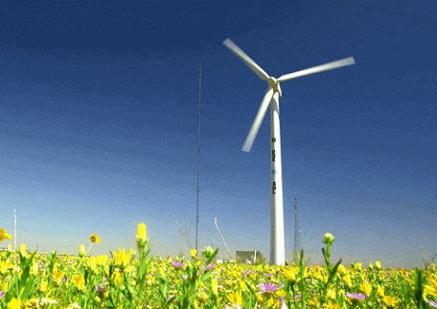
The wind makes the wind mills rotate. The wind mills used to draw water from tube wells and to run flour mills. Wind mills are also used to generate electricity. Air helps in the movements of sailing yachts, gliders, parachutes and aeroplanes.
Birds and insects can fly due to the presence of air. Air also helps in the dispersal of seeds and pollen of flowers of several plants. Air plays an important role in water cycle.

Slide 23
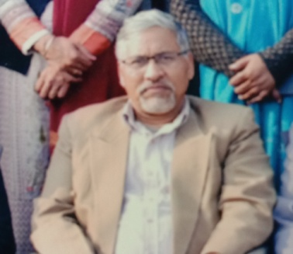
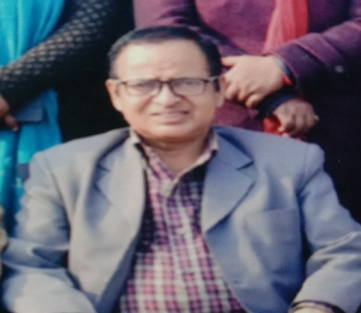
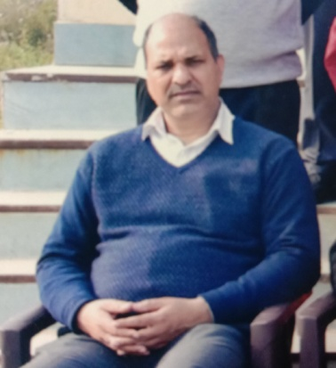
District Education & Training Institute
Udham Singh Nagar
Motivation – Mr. Dharam Singh Rawat
(D.E.I.T. Principal)
Direction – Mr. Mohan Singh Rawat
(H.O.D.- E.T. Department)
Coordination – Mr. B.P. Joshi
(Coordinator - E.T. Department)

